Slide 1
Python – While loop
Premanand S

Slide 2
While loop
Repeat a specific block of code
Used to iterate over a block of code as long as the test expression (condition) is true
While loop when we don't know the number of times to iterate beforehand
while test_expression:
Body of while

Slide 3
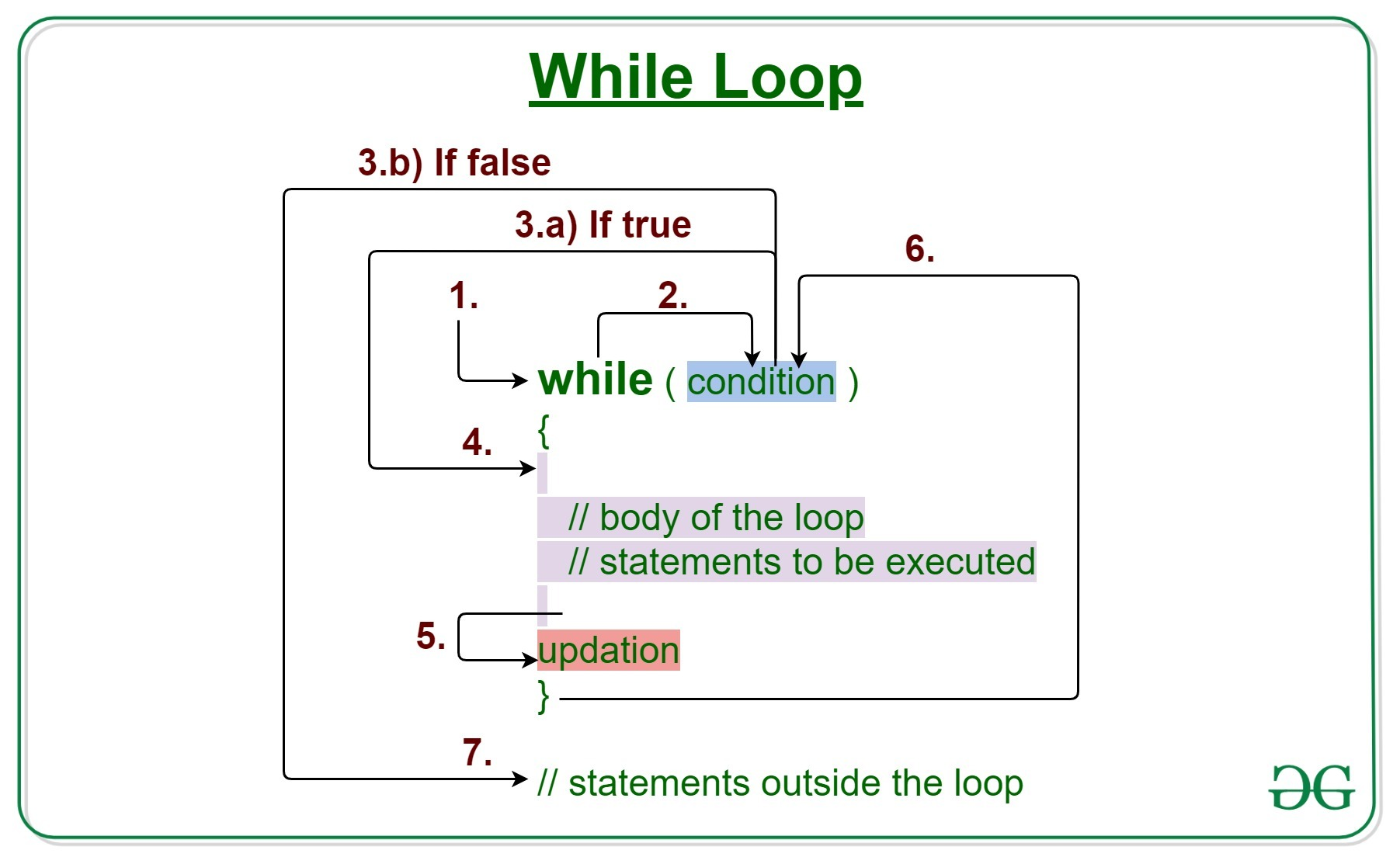
While loop

Slide 4
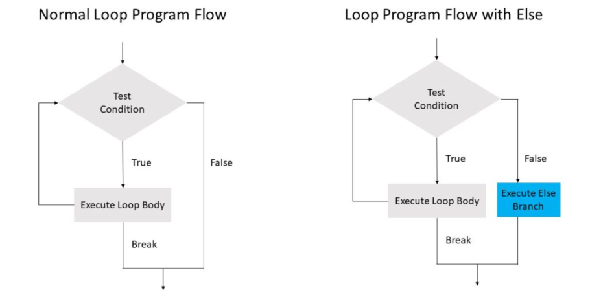
While – Else

